Slide 1

Iterator Design Pattern
Simplifying Access to Collection Elements

Slide 2
Iterator Pattern
The Iterator Pattern provides a way to access elements of a collection sequentially without exposing its internal structure.
It separates the traversal logic from the collection itself.

Slide 3
Why Use it
Hides internal representation of data structures
Makes collection traversal consistent and reusable
Promotes Single Responsibility and Open/Closed Principles
Enables different ways to iterate (forward, backward, filtered, etc.)

Slide 4

Example
Think of a TV remote
You use buttons to go to the next or previous channel
without knowing how the channels are stored inside the TV.
The Iterator Pattern works the same way.

Slide 5
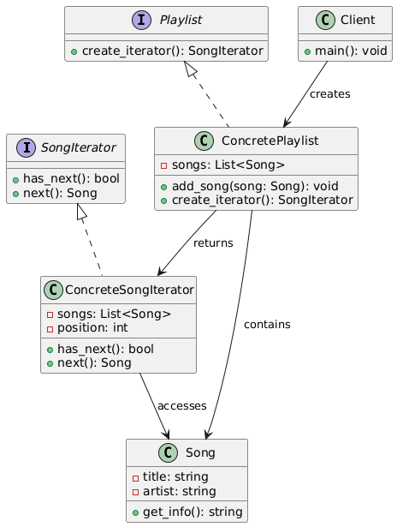
The UML

